Slide 1
Asset Inspections
With Inspection & Survey (I&S)

Slide 2

The business challenges
Limited data access & office-only data
Manual breakdown of inspection tasks
Compliance challenges
Poor GPS accuracy
Intermittent cell coverage and accessibility
Lack of organizational data access
Tedious breakdown of features into inspectable/surveyable items
Progress reporting
Scheduling efforts for recurring inspections
Difficulty in tracking and archiving historical user locations for forensics
Complex data storage and management requirements
2

Slide 3

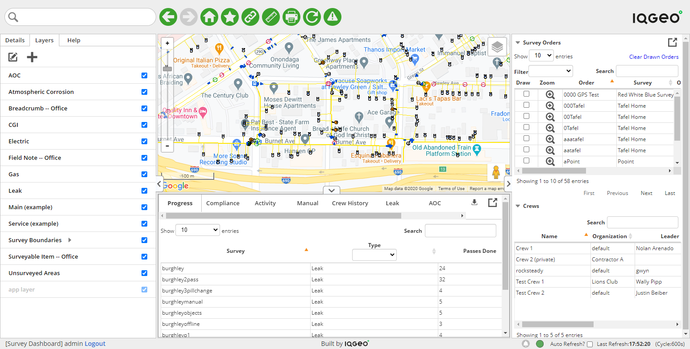


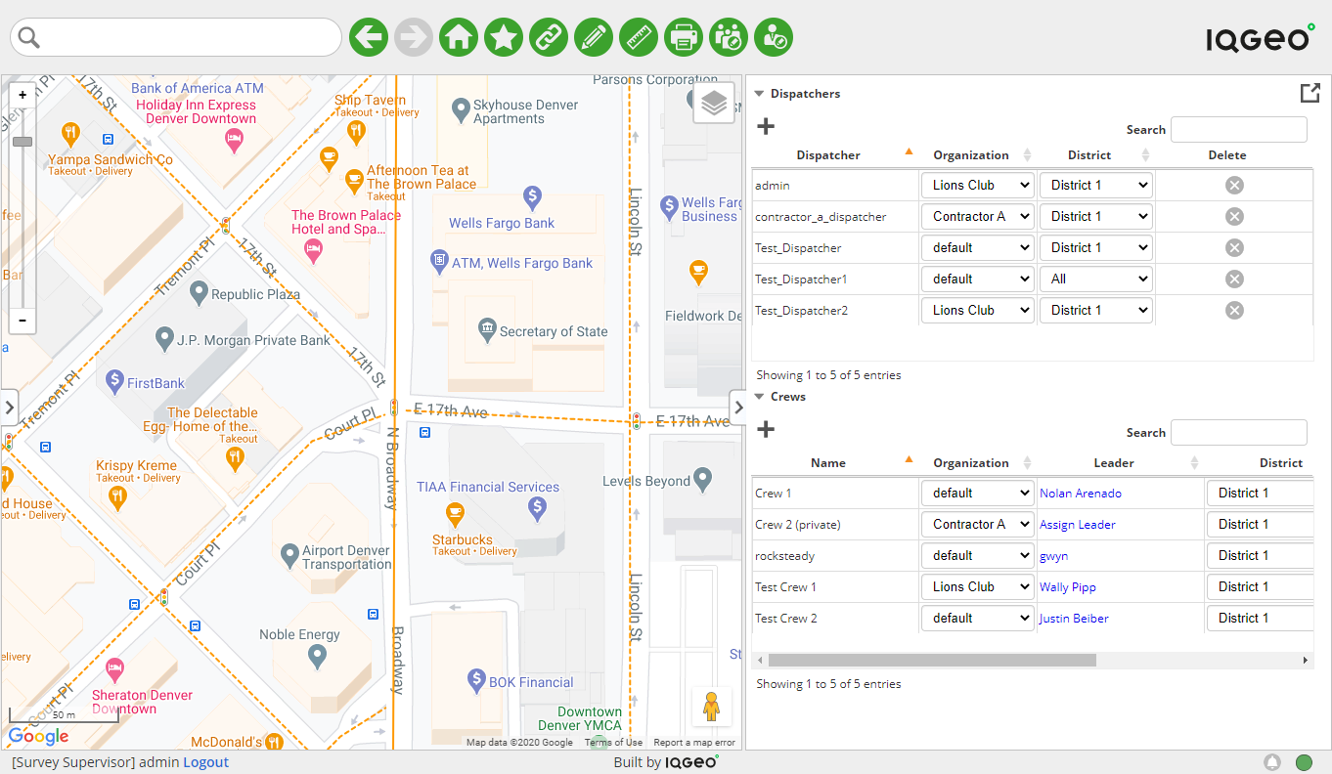
I&S – Asset Inspections
Fully integrated inspection & survey capabilities for oversight and compliance
Ready to fit your operational processes
Out-of-the-box handling for both pessimistic (inspection) and optimistic (survey) approaches
Automated compliance
Powerful breadcrumbing and archiving is handled seamlessly while your crews perform their work
Persona-based
Role-based views and workflows for all key resources in your operational team
Integrated workflows
Configurable and dynamic smart forms to capture every inspection and survey detail
3

Slide 4
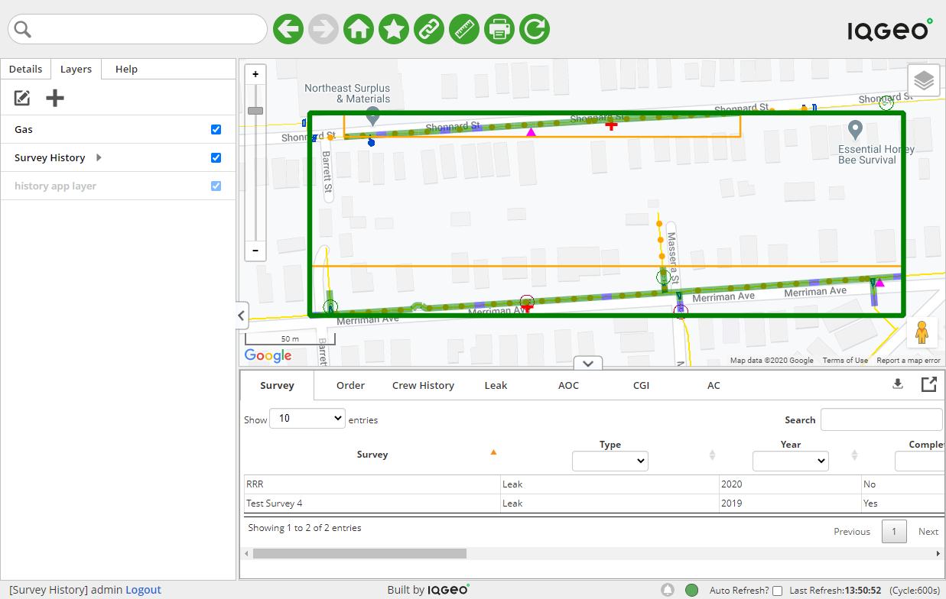
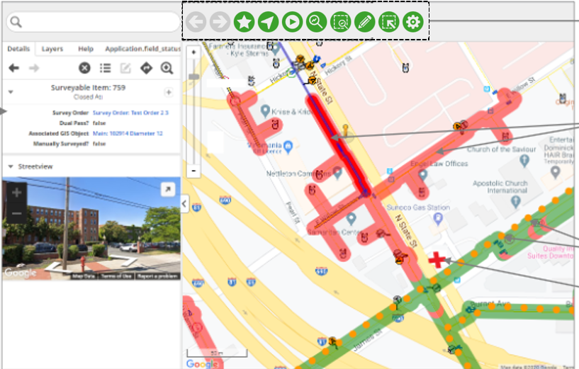
I&S – Asset Inspections
Functional overview
Survey Supervisor – Set up and manage dispatchers and crews
Survey Office – Setup inspections and surveys with asset-based inspectable/surveyable items, order recurrence and crew assignments
Survey Field – Complete inspections and surveys in the field with smart forms and breadcrumbing
Survey Dashboard – Monitor survey progress, view availability of crews for surveys/inspections and generate reports
Survey History – Access, review and download historical inspection and survey data archives
Survey Admin – Configure dynamic smart forms and add/manage supervisors and organizations
Survey history application
Survey field application
4

Slide 5

I&S – Asset Inspections
Benefits
Automated compliance
Flexible digital workflows
Breadcrumb and archiving performance
Know who inspected what, when they did it and exactly where they were
Streamline historical research and forensics
View active and historical progress for orders
Reduces onboarding time and efforts with role-based interfaces
Dynamic smart forms adapt to evolving business processes without additional coding
React effortlessly to loss in cell coverage and GPS
Keeps inspection crews working
Self-assign multiple orders simultaneously
Preserve device availability and battery life
Stay in sync between the back office and the field
5

